Slide 2
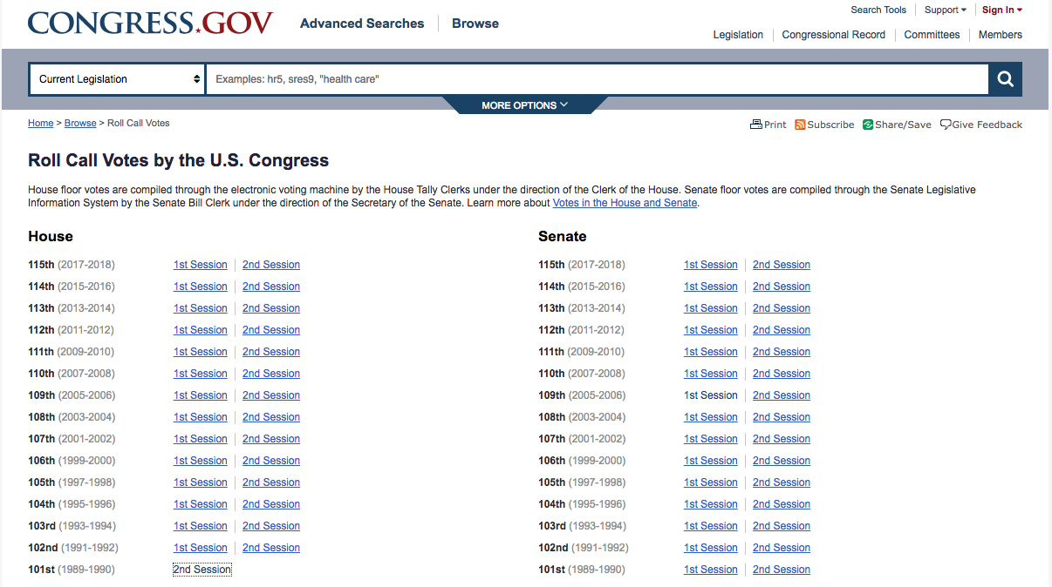
Data Collection
Roll Call Votes are listed by chamber, year, and session.

Slide 3
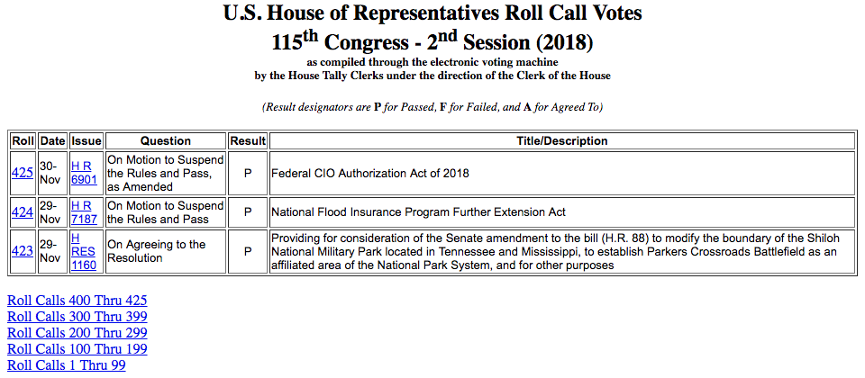
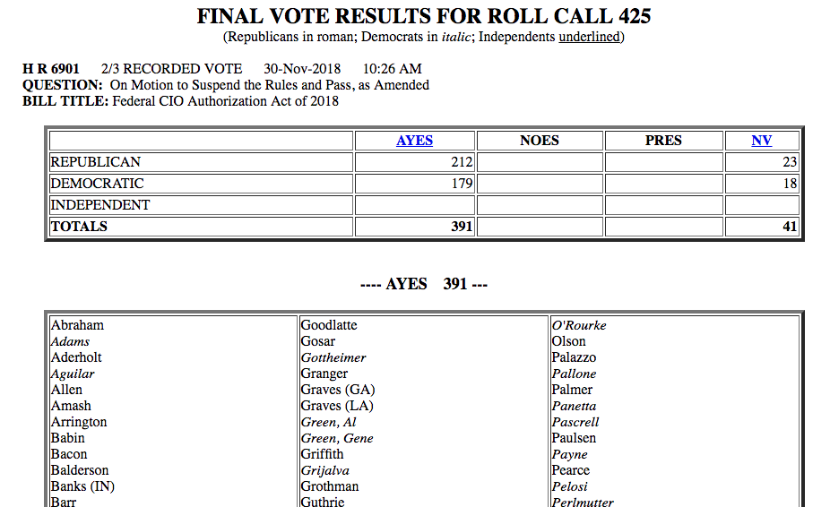
Data Collection
Roll Call Vote summaries are listed in tabular form.
This data was scraped, stored, and formatted.
Roll Call results are listed at the link provided at each Roll number.
This data was also scraped, stored, and formatted.

Slide 4
Data Collection
Roll Call Votes are listed by chamber, year, and session.

Slide 5
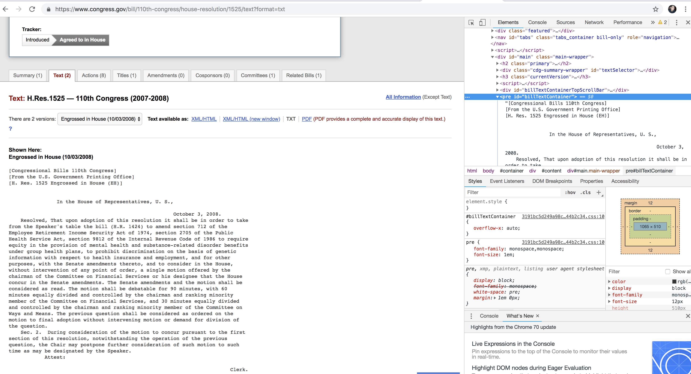
Data Collection
Used bill summary data to scrape the text of each bill. Wrote out to .jsonl file as it’s retrieved.

Slide 6
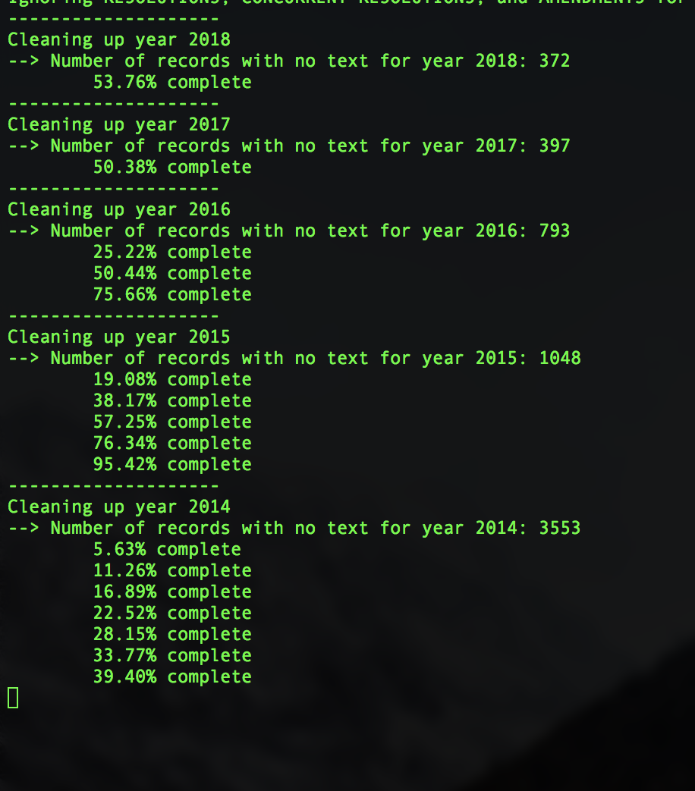
Output from mongo_cleanup.py

Slide 7
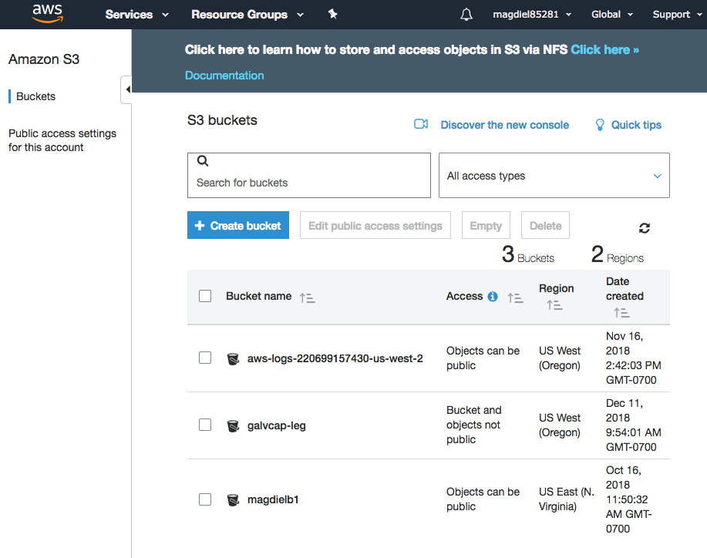
Amazon Web Services: Create an S3 bucket for our data.
Need to change access to write to the bucket galvcap-leg.

Slide 8
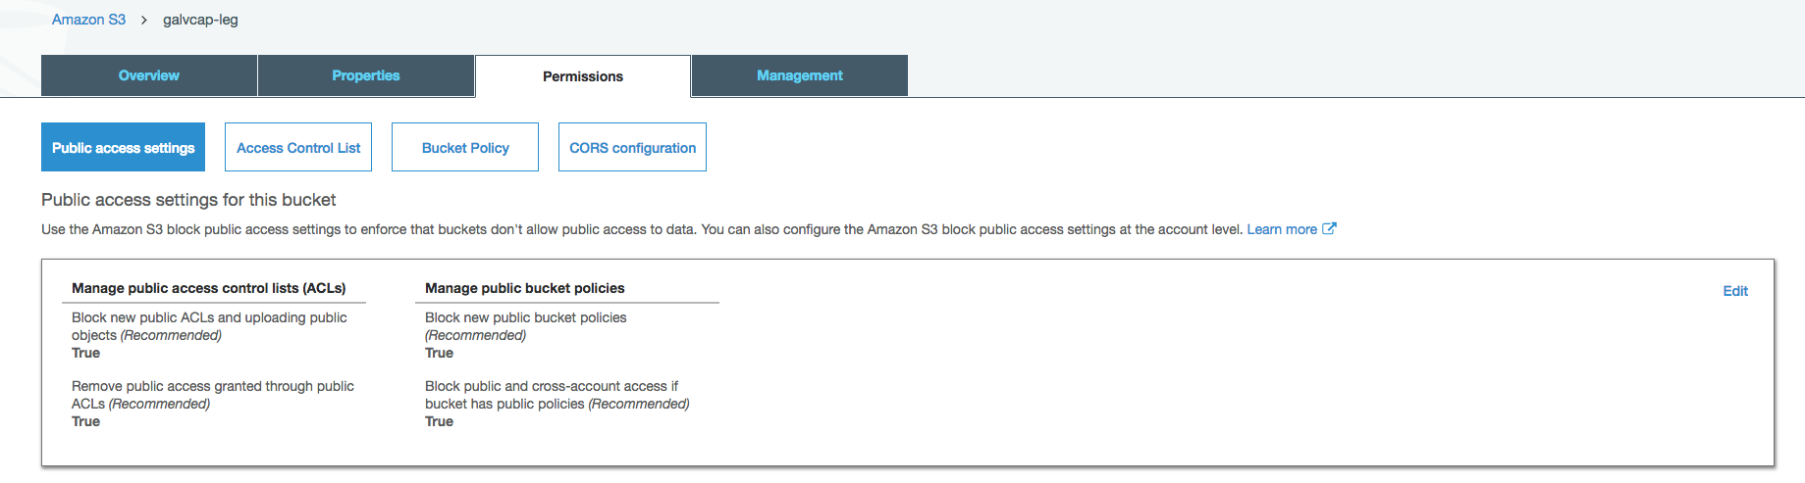
Amazon Web Services: Create an S3 bucket for our data.
Change all of the above values to False.

Slide 9
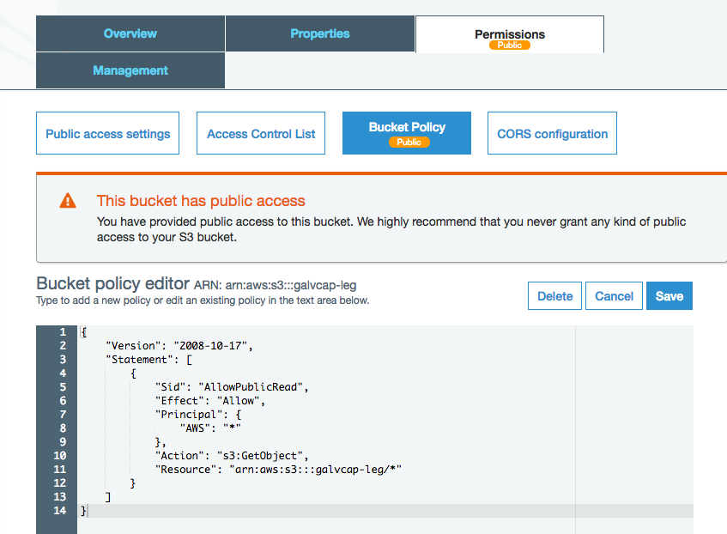
Amazon Web Services: Create an S3 bucket for our data.
Add the code below to change bucket policy.
Once the data is loaded, you may want to change access to the data so only the EC2 instance is able to retrieve what it needs.
{ "Version": "2008-10-17", "Statement": [ { "Sid": "AllowPublicRead", "Effect": "Allow", "Principal": { "AWS": "*" }, "Action": "s3:GetObject", "Resource": "arn:aws:s3:::<your bucket name>/*" } ] }

Slide 10
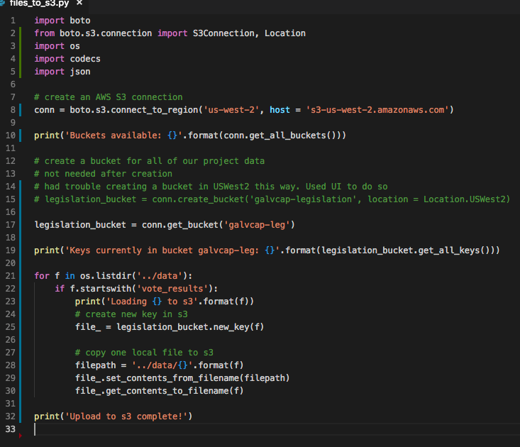
Code to upload to S3.
In order to avoid getting ERRNO 32 BROKEN PIPE, you need to specify host when initiating connection.

Slide 11
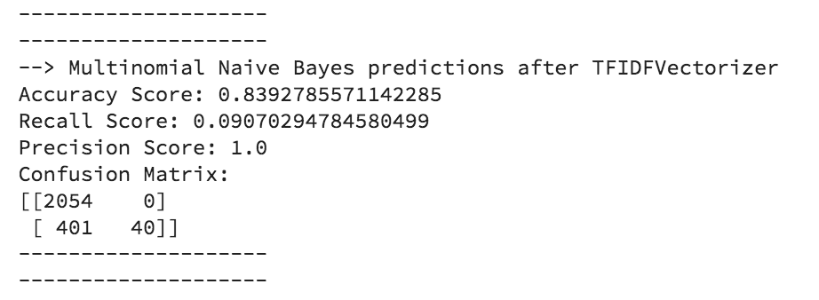
Natural Language Processing
TF-IDF: Term Frequency – Inverse Document Frequency
NLTK word_tokenize and stopwords
WordNetLemmatizer
Results of first iteration with subset of existing data as it’s still rolling in…

Slide 12
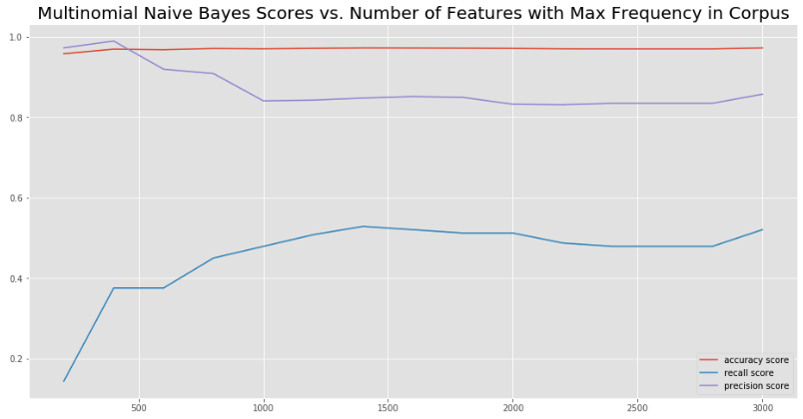
Examined how scores vary with the number of features with the highest frequency
Recall looks like it’s still going up…
Try a few more iterations

Slide 13
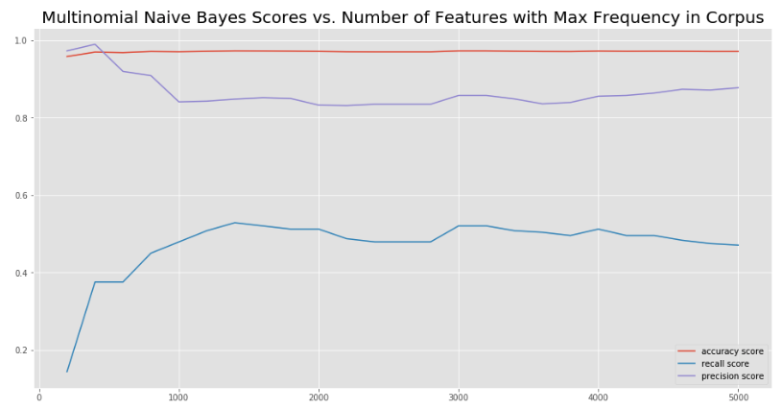
Doesn’t look like it’s improving much by increasing the number of features.
At this point, 3000 features seems to be the best without doing anything else to the model.

Slide 14
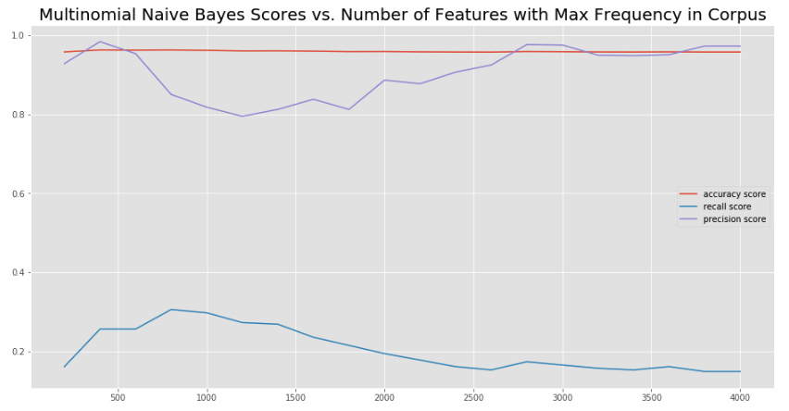
Alpha = 5
Recall maxes out at 800 features, but is only at around 3.5

Slide 15
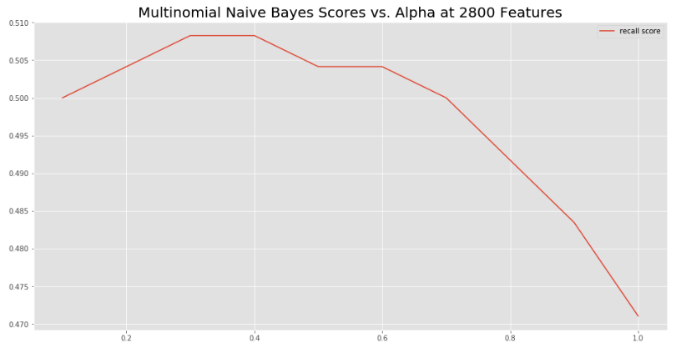
Our recall almost reaches .51 when alpha is between .3 and .4
Let’s up the features…

Slide 16
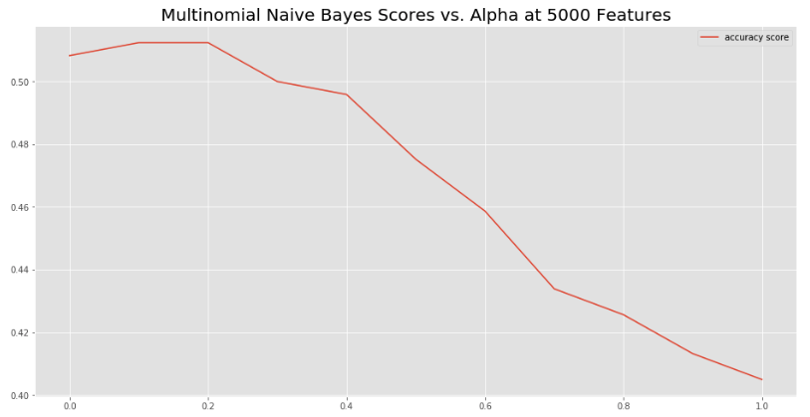
At 5000 features, alpha = 1.5 – 2 gives the best recall.
… splitting hairs at this point. Time to try some other approaches.

Slide 18
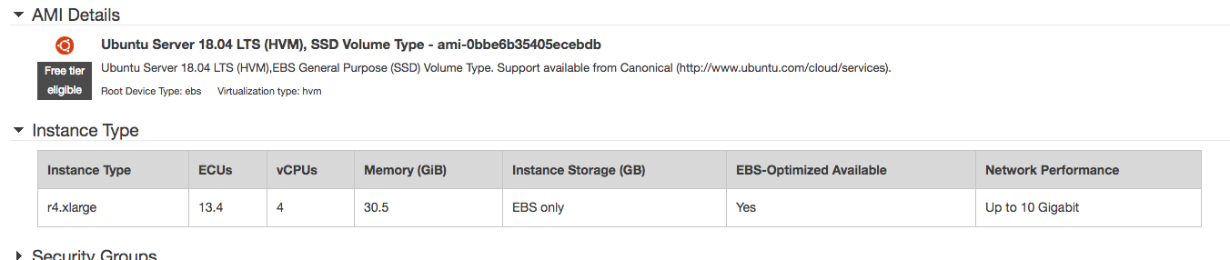
EC2 Instance

Slide 19
EC2 Instance
~/.ssh/config
Host galvanize_capstone
HostName ec2-34-221-255-8.us-west-2.compute.amazonaws.com
User ubuntu
IdentityFile ~/.ssh/galvanize_capstone.pem
Ssh galvanize_capstone
sudo apt update
sudo apt upgrade
wget -S -T 10 -t 5 https://repo.continuum.io/archive/Anaconda3-5.3.1-Linux-x86_64.sh -O $HOME/anaconda.sh
Source ~/.bashrc

